Slide 1
Kinect
Workshop
Marco Franssen & Jan Saris

Slide 2
Who are we?
Marco Franssen
Current assignment
Biobank Maastricht
CQRS HTML5 MVC3 JQuery
Online
@marcofranssen
http://marcofranssen.nl
Jan Saris
Current assignment
Biobank Maastricht
CQRS HTML5 MVC3 JQuery
Online
@jpgsaris

Slide 3
What will we do tonight?
What is Kinect?
Architecture / Cohesion of projects in the solution
Stuff to think about
Workshop

Slide 4
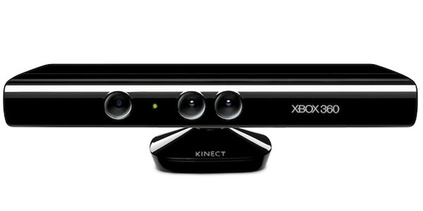
What is Kinect?
Camera
Can track a users body
Can see depth

Slide 5
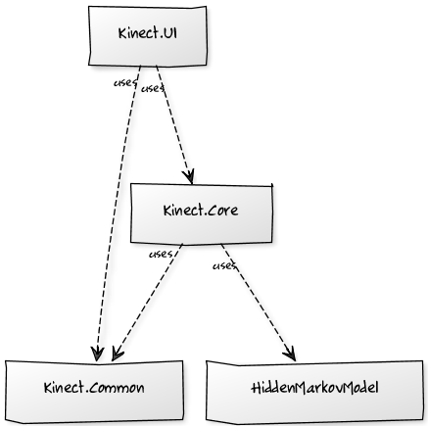
Architecture
Demos
Framework
Extensions

Slide 6
Tips for the workshop
Multi-threading
UpdateUserInterface(() => Stuff you want to do);
Debugging your code
Log as much as possible to the Messages
Performance
30 fps
Solution we make in the Gesture Filter part of the workshop

Slide 7
Workshop
Part 0:
Installation
Part 1:
Discover MyKinect
Part 2:
Detect User
Read User data
Part 3:
Create a Filter
Create a Gesture

Slide 8
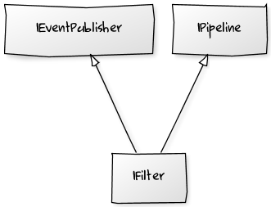

Gestures
Interfaces
Pipelines
Hidden Markov

Slide 9
Resources
https://github.com/atosorigin/Kinect
http://research.microsoft.com/en-us/um/redmond/projects/kinectsdk/

Slide 10
Thanks
For more information please contact: Marco Franssen +31 (0)6 83 62 73 00 marco.franssen@atos.net
Jan Saris +31 (0)6 52 54 22 69 jan.saris@atos.net

